Slide 1
Section 2.7
Naming Inorganic Compounds

Slide 2
Ionic Compounds
1. Cations
a) Single charged metals- name only
Na⁺ sodium
b) Multi charged metals- name and Roman numerals in parentheses:
Fe²⁺ iron (II)
Fe ³⁺ iron (III)

Slide 3
c) Polyatomic cation- end in –ium
NH₄⁺ ammonium
H₃O⁺ hydronium

Slide 4
Ionic Compounds
2. Anions
a) Monatomic anions (nonmetals)- replace suffix with –ide
O²⁻ oxide
N³⁻ nitride
b) Polyatomic anions- name only
NO₃⁻ nitrate
NO₂⁻ nitrite

Slide 5
Ionic Compounds
c) Anions derived from adding H⁺ to an oxyanion:
CO₃²⁻ carbonate
HCO₃⁻ hydrogen carbonate or bicarbonate
PO₄³⁻ phosphate
H₂PO₄⁻ dihydrogen phosphate

Slide 6
Ionic Compounds
3. Compounds
Names cation, then anion
CaCl₂ calcium chloride
AlPO₃ aluminum phosphite
CuSO₄ copper (II) sulfate

Slide 7
Ionic Compounds
To get formula from the name:
Write the symbols of the cation and anion
Determine their charges (using periodic table, roman numerals, or memorized polyatomic charge)
Crisscross charges down to subscripts
Reduce subscripts to lowest ratio

Slide 8
Acids
-ides
-ates /-ites

Slide 9
Acids
1. With anions ending in –ide: change –ide to –ic, add the prefix hydro-, and follow with the word acid
Watch for roots of S and P
Anion | Corresponding Acid
Cl⁻ (chloride) | HCl (hydrochloric acid)
S²⁻ (sulfide) | H₂S (hydrosulfuric acid

Slide 10
Acids
2. With anions ending in –ate or –ite:
Change –ate to –ic
Change –ite to –ous
Add the word acid
Anion | Corresponding Acid
ClO₄⁻ (perchlorate) | HClO₄ (perchloric acid)
ClO₃⁻ (chlorate) | HClO₃ (chloric acid)
ClO₂⁻ (chlorite) | HClO₂ (chlorous acid)
ClO⁻ (hypochlorite) | HClO (hypochlorous acid)

Slide 11
Acids
To get the formula from the name:
Write H for the hydrogen and then the symbol of the anion
Give hydrogen the subscript equal to the charge on the anion (do not write “1” for one)

Slide 12
Binary Molecular Compounds
Contain two nonmetals (or metalloids)
No metals!!
No polyatomic ions!
No roman numerals!
This is much easier than ionics (yay!)

Slide 13
Molecular Compounds (Binary)
1. Name the first element as it appears on periodic table
2. Name second with an –ide ending
3. Use a Greek prefix to indicate number of atoms of each element
Exception: do not use mono- with first element

Slide 14
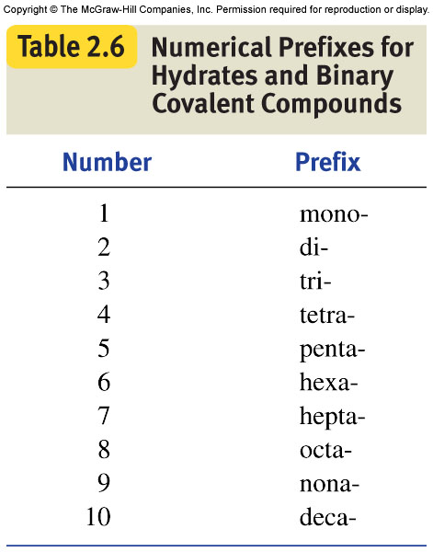

Slide 15
Additional Prefixes
11
11 – hendeca-
12 – dodeca-
13 – triskaideca-
14 – tetradeca-
15 – pentadeca-
12
13
14
15

Slide 16
16
16 – hexadeca-
17 – heptadeca-
18 – octadeca-
19 – ennedeca-
20 – icosa-
17
18
19
20

Slide 17
Molecular Compounds (binary)
To get the formula from the name:
Write the symbol of each element
Use prefixes to determine subscripts
DO NOT REDUCE SUBSCRIPTS!

Slide 18
Example Problems
CCl₄
As₂O₃
SO₂
NF₃

Slide 19
Example Problems
Carbon monofluoride
Sulfur difluoride
Disilicon tetraoxide
Hexacarbon decahydride
Hendecabromine icosachloride
Octanitrogen dodecaiodide
Triskaidecabromine hexadecasulfide

